Slide 1

Home Loan Analytics
-
Submitted By: Krishna Gopal Goswami

Slide 2
Agenda
Business Objectives
Data Preparation
Analysis
Models
Insights

Slide 3
Business Objectives
Identify important factors leading to approval of giving customer a home loan
Check if average loan amount is same across Gender, Marital Status etc.
Provide insights about trend of properties in the sanction of home loan

Slide 4
Data Understanding

Slide 5
Brief about the dataset
The dataset contains Loan Data of ~600 customers related to Home Loan.
Following fields are available in the dataset:
Loan_ID: Unique loan Id of the customer
Gender: Male/Female
Married: Applicant is married or Not (Y/N)
Education: Education of the applicant
Self_Employed: Is the customer Self-Employed (Y/N)
ApplicantIncome: Income of the applicant
CoapplicantIncome: Income of the co-applicant
LoanAmount: Loan amount in thousands
Loan_Amount_Term: Term Loan in months
Credit_History: Whether Credit History meets Guidelines (Y/N)
Property_Area: Urban/ Semi-Urban/ Rural
Loan_Status: Loan is approved or not(Y/N)

Slide 6
Data Preparation

Slide 7
Data Cleaning (Remove NaNs)
There are Blank (NaNs) values for some of the variables.
Different techniques are used to impute the missing values, details are in next slides.
Field Name | No of Records with NaN
Gender | 13
Married | 3
Dependents | 15
Self_Employed | 32
LoanAmount | 22
Loan_Amount_Term | 14
Credit_History | 50

Slide 8
Data Cleaning (Remove NaNs) Contd.
Impute Gender: The missing values in Gender is imputed with Male, as Percentage of Male is much higher than that of Female.
Breakup of Gender is:
Impute Married: The missing values in Married is imputed with Yes, as Percentage of Married=Yes is higher than that of Married=No.
Breakup of Married is:
Gender | Count | Percentage
Male | 489 | 81
Female | 112 | 19
Married | Count | Percentage
Yes | 398 | 65
No | 213 | 35

Slide 9
Data Cleaning (Remove NaNs) Contd.
Impute Dependents: The missing values in Dependents is imputed with 0, as Percentage of Dependents=0 is higher than that of other values.
Breakup of Dependents is:
Impute Self-Employed: The missing values in Self_Employed is imputed with No, as Percentage of Self_Employed=No is higher than that of Self_Employed=Yes.
Breakup of Self_Employed is:
No of Dependents | Count | Percentage
0 | 345 | 58
1 | 102 | 17
2 | 101 | 17
3+ | 51 | 8
Self_Employed | Count | Percentage
No | 500 | 85
Yes | 82 | 15

Slide 10
Data Cleaning (Remove NaNs) Contd.
Impute Credit_History: The missing values in Credit_History is imputed with 1, as Percentage of Credit_History=1 is higher than that of Credit_History=0.
Breakup of Credit_History is:
Impute Self-Employed: The missing values in Self_Employed is imputed with No, as Percentage of Self_Employed=No is higher than that of Self_Employed=Yes.
Breakup of Self_Employed is:
Credit_History | Count | Percentage
1 | 475 | 84
0 | 89 | 16
Self_Employed | Count | Percentage
No | 500 | 85
Yes | 82 | 15

Slide 11
Data Cleaning (Remove NaNs) Contd.
Impute Credit_History: The missing values in Credit_History is imputed with 1, as Percentage of Credit_Hisoty=1 is higher than that of Credit_History=0.
Breakup of Credit_History is:
Impute Loan_Amount_Term: The missing values in Loan_Amount_Term is imputed with mean value.
Credit_History | Count | Percentage
1 | 475 | 84
0 | 89 | 16

Slide 12
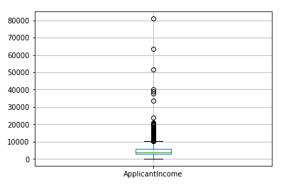
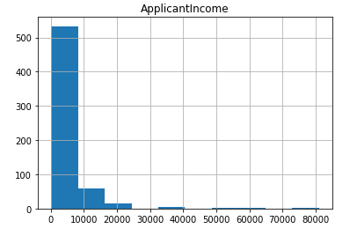
Data Cleaning (Remove Outliers) Contd.
Remove Outlier for ApplicantIncome: There are 7 records with ApplicantIncome > 25000. They are removed as part of data cleaning. Box plot and Histogram is shown below for reference:

Slide 13
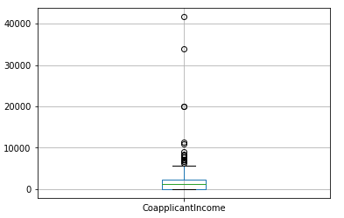
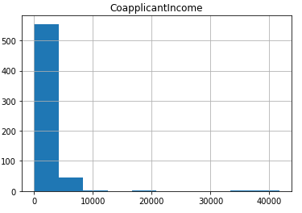
Data Cleaning (Remove Outliers) Contd.
Remove Outlier for CoapplicantIncome: There are 6 records with CoapplicantIncome > 9000. They are removed as part of data cleaning. Box plot and Histogram is shown below for reference:

Slide 14
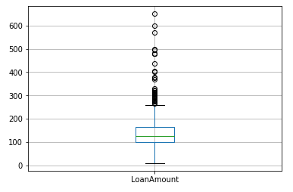
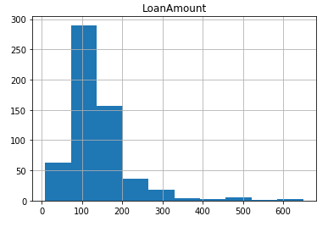
Data Cleaning (Remove Outliers) Contd.
Remove Outlier for LoanAmount: There are 3 records with LoanAmount > 500 thousands. They are removed as part of data cleaning. Box plot and Histogram is shown below for reference:

Slide 15
Data Analysis

Slide 16
Check Dependency of Loan Status in Credit History
As per sample data, customers with Credit_History=Y have higher percentage of Loan_Approved = Y.
Chi-Square test is executed to validate the same statistically. As Chi-Square Value is higher and p value < 0.05, so we can infer that there is significant dependency between Credit_History and Loan_Status.
Loan_Status | N | Y | All
Credit_History
0 | 76 | 6 | 82
1 | 96 | 397 | 493
All | 172 | 403 | 575

Slide 17
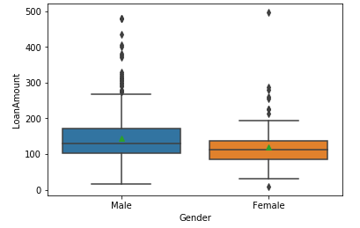
Check If Avg Loan Amount is same across different Gender
 | Loan Amount (In thousands)
Gender
Female | 120
Male | 144
Mean Loan Amount of Men is higher than the
mean of Female
Visualize via boxplot how far apart the means
from each other
Run Anova F-Test to validate it statistically.
As F-Statistic is high (10.57) and p-value
is 0.00122(which is < 0.05), so it can be inferred
that there is relationship between Loan Amount
and Gender

Slide 18
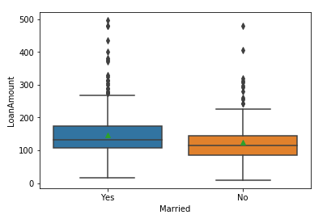
Check If Avg Loan Amount is same for Married and Un-married
 | Loan Amount (In thousands)
Married
No | 125
Yes | 147
Mean Loan Amount of Married customers is
higher than the mean of Unmarried
Visualize via boxplot how far apart the means
from each other
Run Anova F-Test to validate it statistically.
As F-Statistic is high (13.15) and p-value
is 0.000312(which is < 0.05), so it can be inferred
that there is relationship between Loan Amount
and Married

Slide 19
Modeling

Slide 20
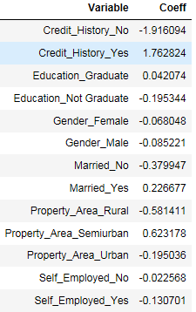
Logistic Regression Model
Used the following independent categorical variables as input
Gender, Married, Education, Self_Employed, Credit_History,
and Property_Area
Converted them to numerical variable via dummy coding
Created Train and Test data set
Loan_Status is dependent variable
Built Logistic Regression model and the
values of co-efficients is mentioned

Slide 21
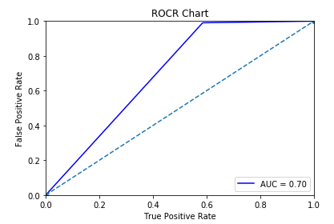
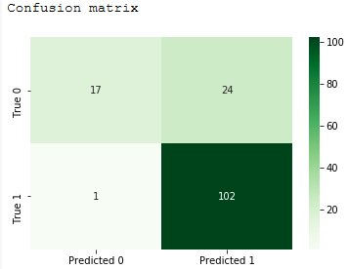
Logistic Regression Model (Contd.)
ROCR chart is mentioned here
AUC score of the model is 0.70
Accuracy score of the model is 0.82
Confusion matrix is:

Slide 22
Insights

Slide 23
Factors affecting Loan Approval Decision
Following properties of the customers have positive affect loan approval and the company can target more on customers with the following characteristics:
Credit History = Yes
Education = Graduate
Married = Yes
Property = Semi-Urban
We are able to predict Loan Approval Status with 82% accuracy based on our logistic regression model.

Slide 24
GitHub Link
The project is developed using Python and R and the python/R can be downloaded from the below GitHub Link:
https://github.com/kgopal1982/Analytics/blob/master/HomeLoanAnalytics/HomeLoanAssessment.ipynb
https://github.com/kgopal1982/Analytics/blob/master/HomeLoanAnalytics/HomeloanAnalytics_usingR.R

Slide 25
Thank You

